Slide 1
GDSC EPITA
Introduction to Deep Learning Workshop
Philippe Bouchet
EPITA SANTE 2023

Slide 2
Presentation ~ 30 min
Workshop ~ 1h30

Slide 3
Summary
Who am I?
What is AI?
Deep learning in the real world
But how does it work?
QnA

Slide 4
This is NOT an advanced deep learning course.
This is a workshop for budding AI and DL enthusiasts. No maths! ;)

Slide 5

Who am I?
Philippe Bouchet
EPITA Majeure SANTE 2023, Healthcare Major
We specialize in:
AI and image processing for healthcare
Tech solutions for medical problems
Brain tumor detection
Segmentation of gray/white matter
Bridging the gap between developers and doctors

Slide 6
What is AI?

Slide 7
What is AI?
What’s the difference between AI, ML and DL?

Slide 8
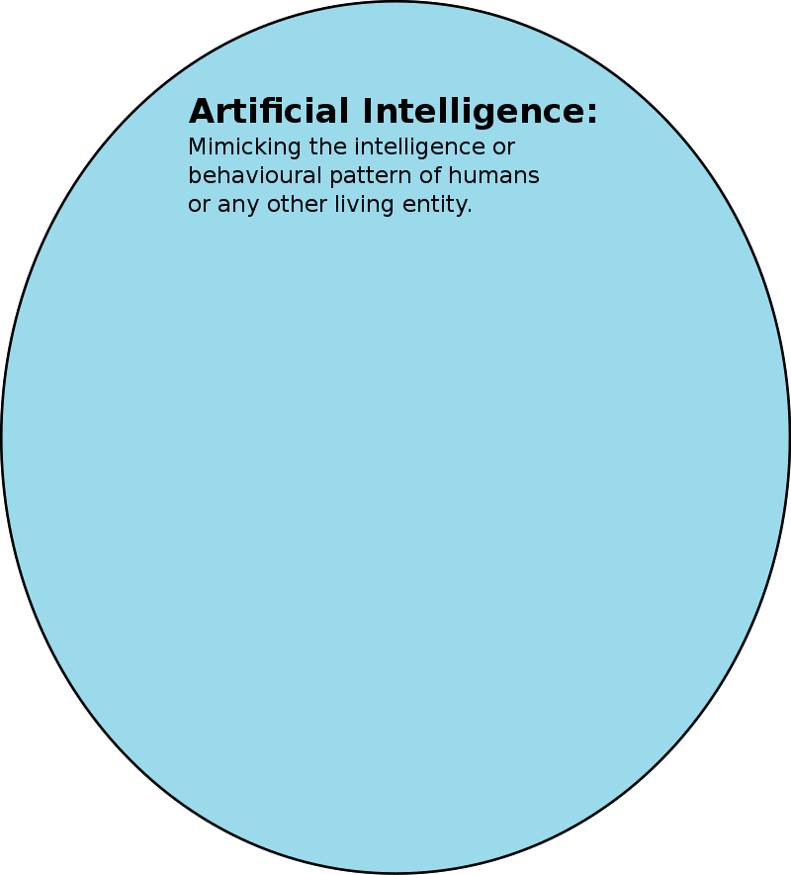
What is AI?
Artificial Intelligence
NPCs in video games
Minimax algorithm
A* path search algorithm

Slide 9
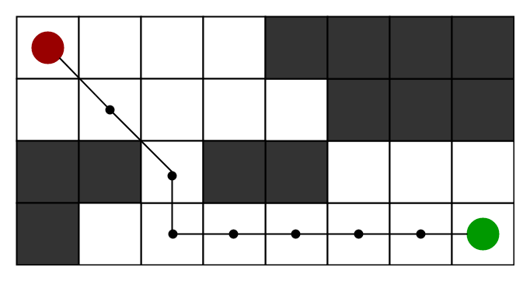
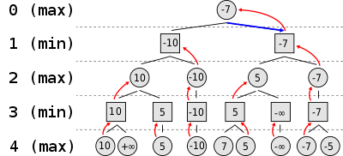
What is AI?
A* pathfinding algorithm
Minimax algorithm

Slide 10
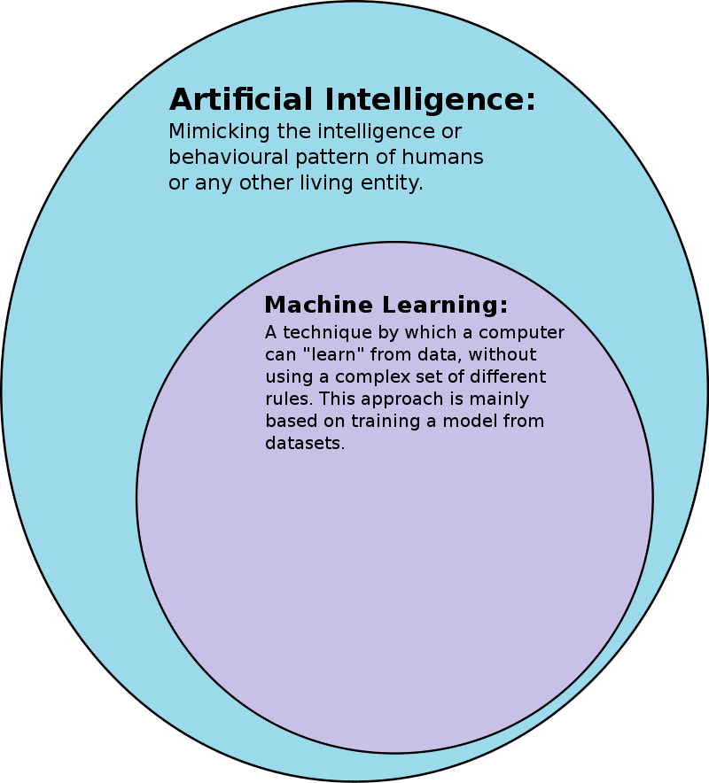
What is AI?
Artificial Intelligence
Machine Learning
Using data to improve a statistical model’s accuracy
Supervised learning (labeled data)
Classification, regression

Slide 11
What is AI?
X | y
1 | 10
2 | 20
3 | 30

Slide 12
What is AI?
How do we estimate the
value of the new data?
X | y
1 | 10
2 | 20
3 | 30
4 | ?

Slide 13
What is AI?
How do we estimate the
value of the new data?
f(x) = 10 * x
X | y
1 | 10
2 | 20
3 | 30
4 | 40

Slide 14
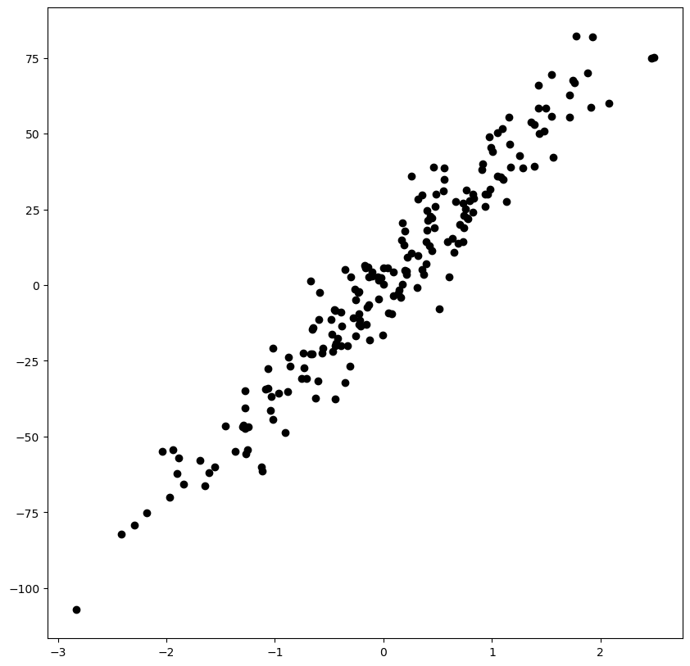
What is AI?
Linear regression example
n_samples = 200
n_features = 1
We have a dataset that maps X to y
Goal: Function f that best fits the data
f(x) = ax + b, what is a and what is b?

Slide 15
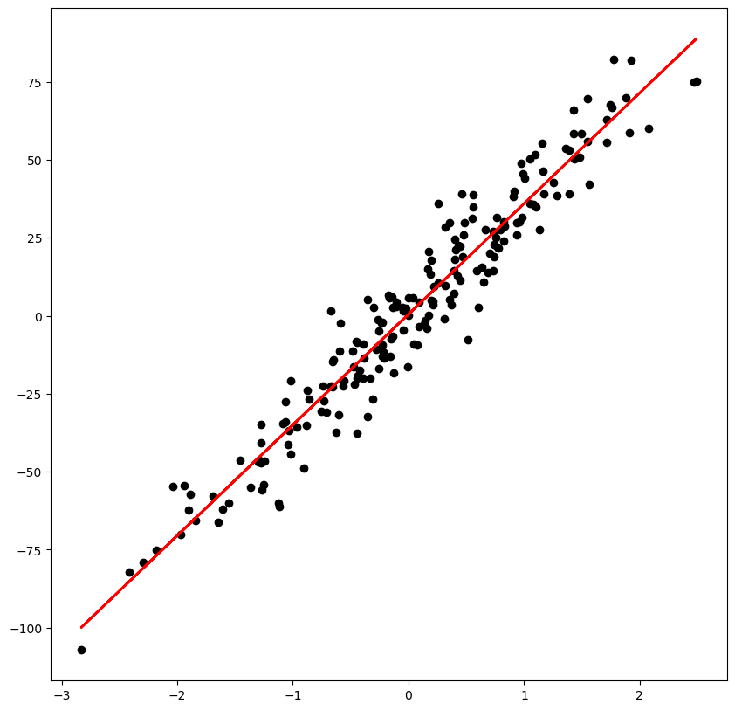
What is AI?
Linear regression example
n_samples = 200
n_features = 1
We have a dataset that maps x to y
Function f that best fits the data?
f(x) = 35.59x + 2.227

Slide 16
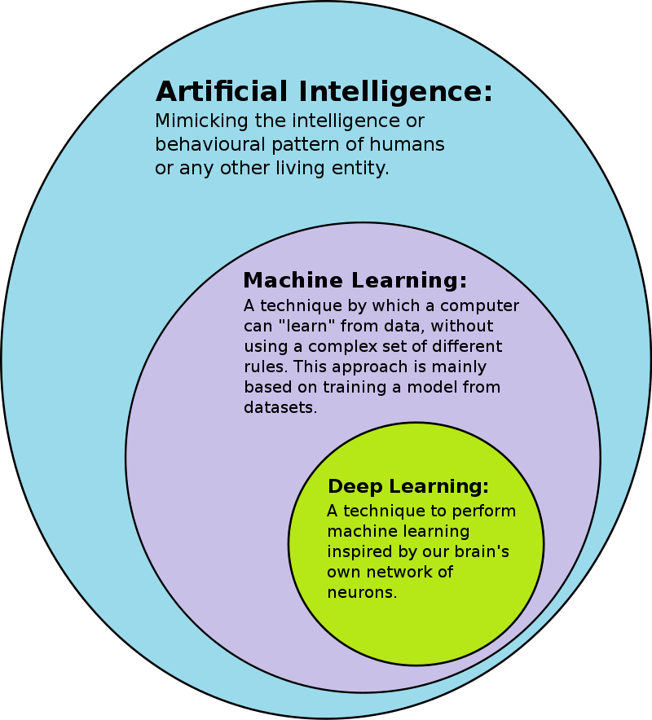
What is AI?
Artificial Intelligence
Machine Learning
Deep Learning
Deep learning because we use deep neural networks
NLP
Image segmentation

Slide 17
What is AI?
What is a neural network?

Slide 18
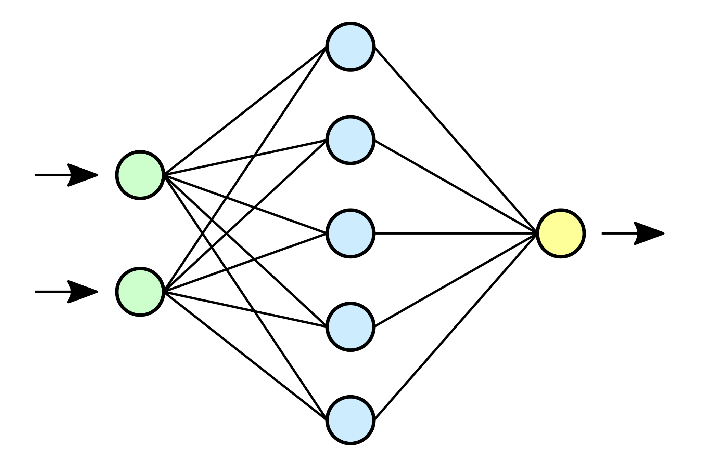
What is AI?
What is a neural network?

Slide 19
What is AI?
What is a neural network?
Input layer
Hidden layer
Output layer

Slide 20
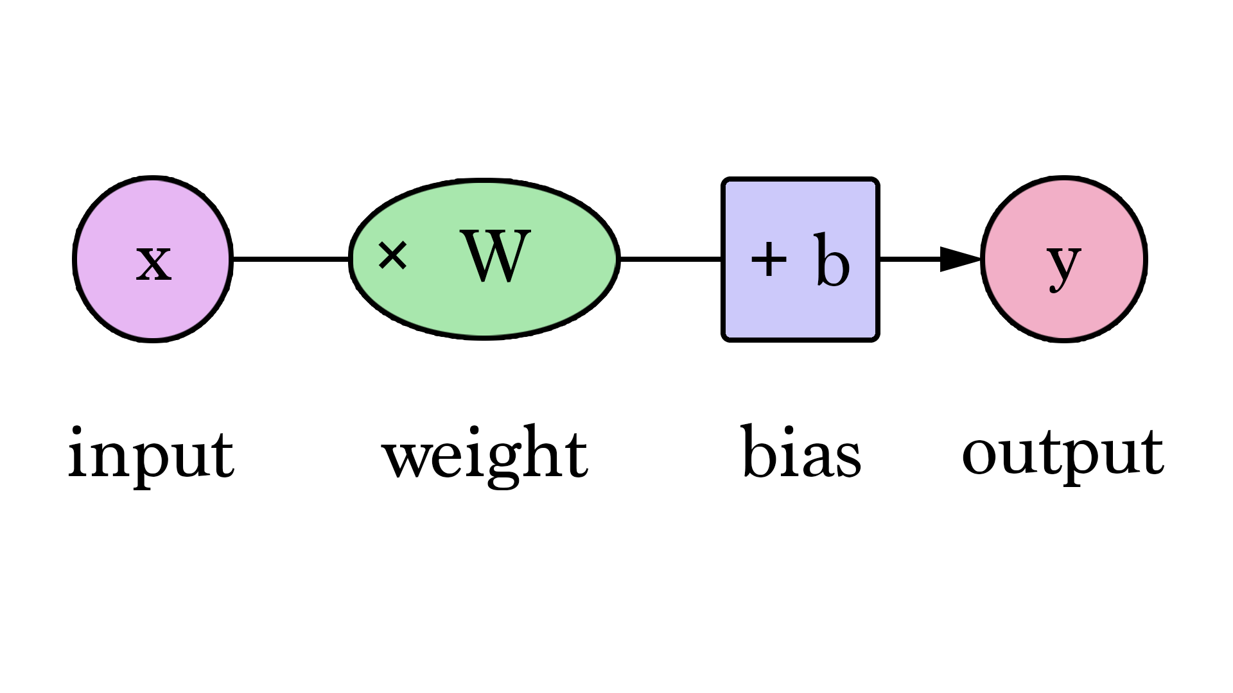
What is AI?
What is a neural network?
Input layer
Hidden layer
Output layer
Parameters
Weights
Biases
Linear operations

Slide 21
What is AI?
What is a neural network?
Input layer
Hidden layer
Output layer
Parameters
Weights
Biases
Linear operations
Useful for simple tasks in ML
Classification
Regression

Slide 22
What is AI?
Limitations
Only linear activations
2 dimensions in this example
What about 784 dimension?

Slide 23
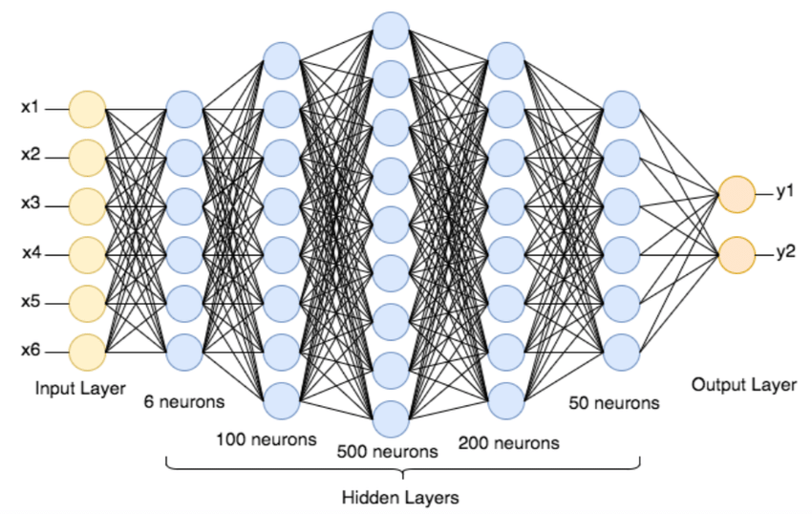
What is AI?
Add more hidden layers!
Deep Neural Network
Non linear models
Time consuming computation
More capacity to learn
https://en.wikipedia.org/wiki/Universal_approximation_theorem

Slide 24
Deep learning in the real world
An example of a DNN (Deep Neural Network)

Slide 25

Deep learning in the real world
Convolutional Neural Networks
Convolution kernel (5x5)
Max-pool to reduce size
Repeat
Fully connected
Prediction

Slide 26
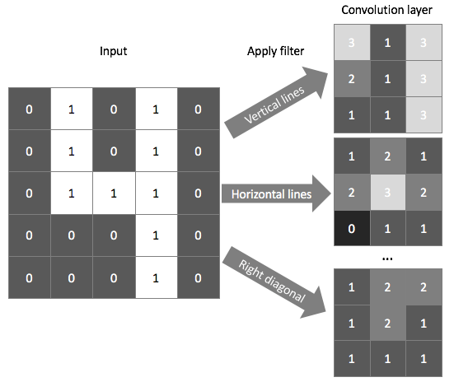

Slide 27
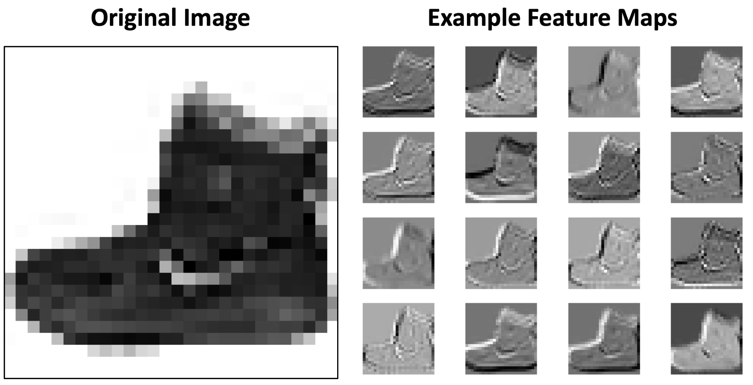

Slide 28

Deep learning in the real world
Convolution

Slide 29
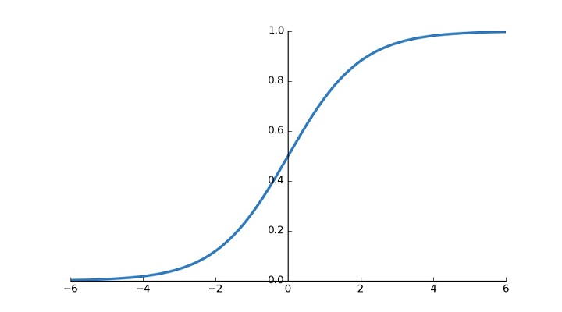
Softmax

Slide 30
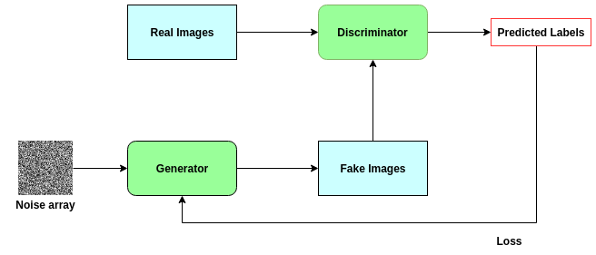
Deep learning in the real world
Generative Adversarial Network (GAN):
Ian J. Goodfellow et al. 2014
Generates fake images from noise
Discriminator guess if it’s a real image or not
Generator is updated with loss
https://arxiv.org/pdf/1406.2661.pdf

Slide 31
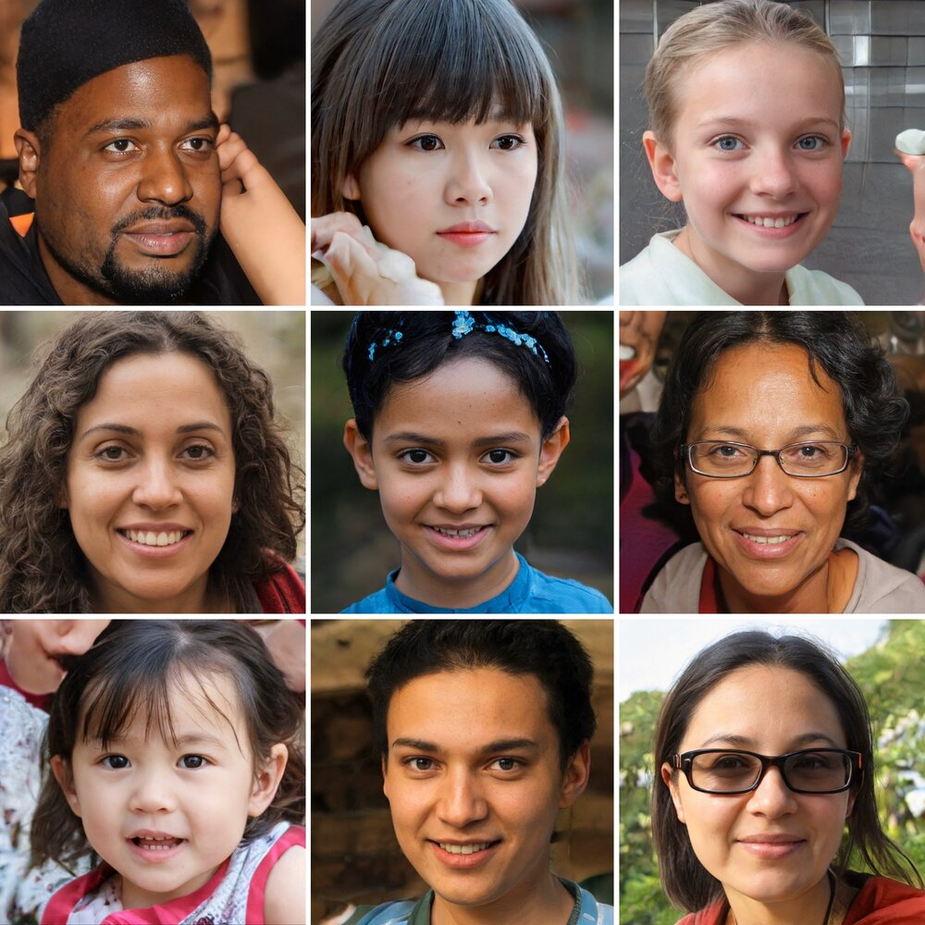
Deep learning in the real world - Some examples
This person does not exist
https://thispersondoesnotexist.com/

Slide 32
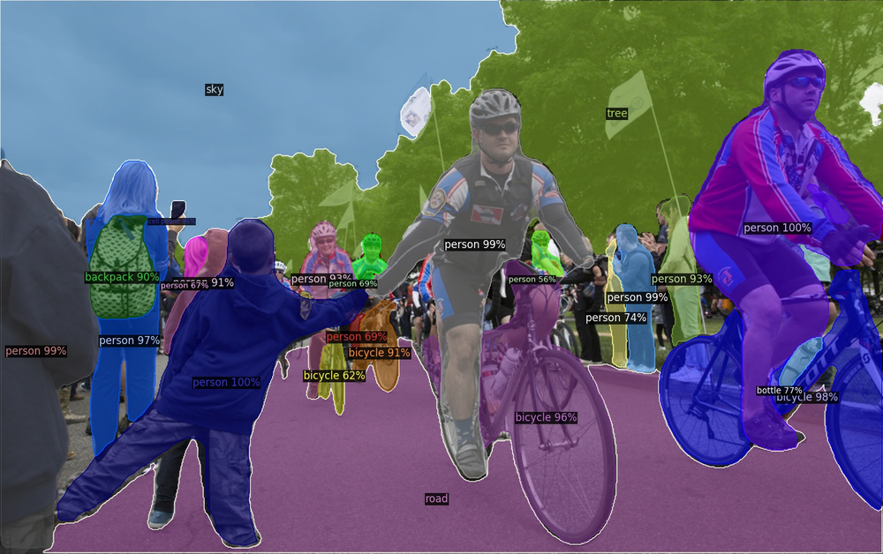
Deep learning in the real world - Some examples
Image segmentation:
Facebook’s detectron
https://github.com/facebookresearch/Detectron

Slide 33
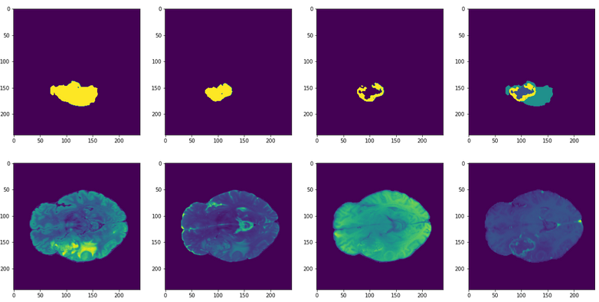
Deep learning in the real world - Some examples
Brain tumor segmentation

Slide 34
Deep learning in the real world
What are the frameworks to develop DNN models?

Slide 35


Deep learning in the real world
Python
Tensorflow, simple API with Keras
PyTorch, a bit difficult to get into

Slide 36

Deep learning in the real world
Python
C/C++/FORTRAN
Low-level GPU Optimizations with CUDA
Deep learning depends on GPUs

Slide 37
Deep learning in the real world
But why GPUs?

Slide 38
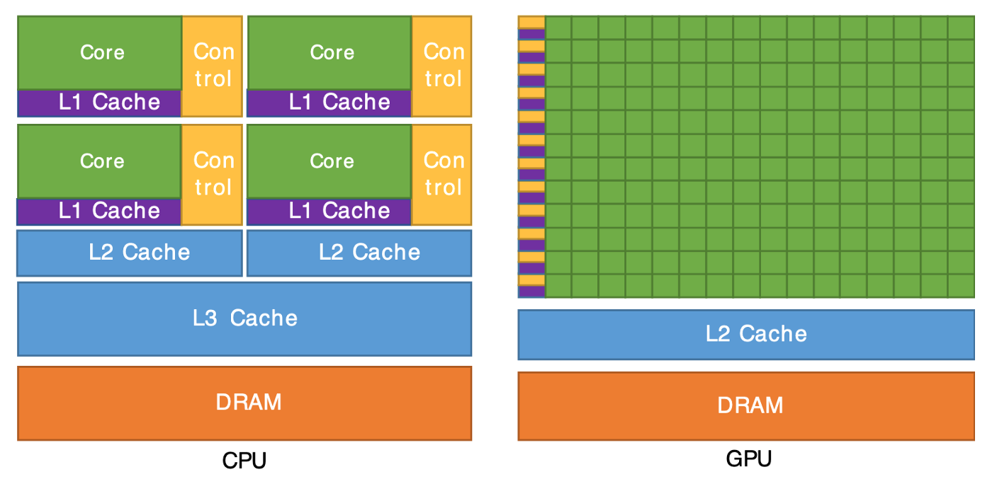
Deep learning in the real world
But why GPUs?
Many cores (ALUs)
Parallelizable code
Accelerate model training

Slide 39
Deep learning in the real world
But what about in daily life?

Slide 40

Deep learning in the real world
Deep learning is used everywhere!
To unlock your phone with face ID

Slide 41

Deep learning in the real world
Deep learning is used everywhere!
To unlock your phone with face ID
When you use Google translate

Slide 42
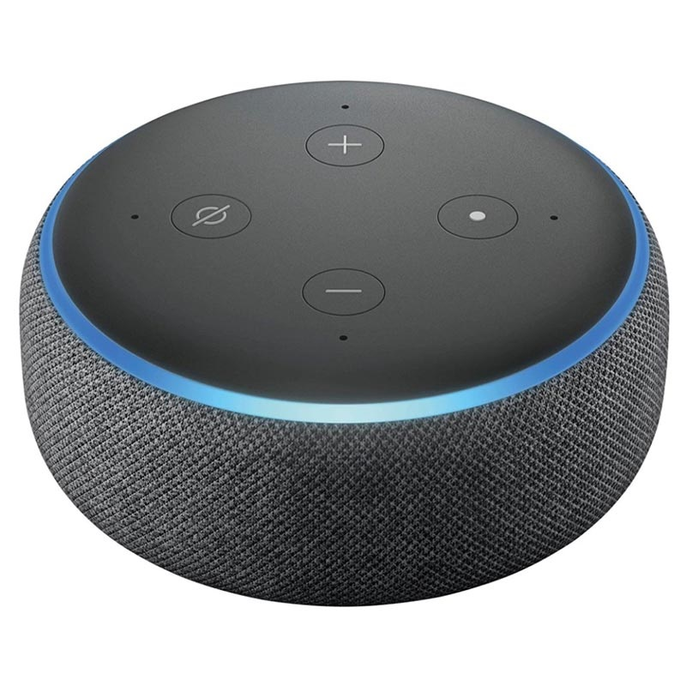
Deep learning in the real world
Deep learning is used everywhere!
To unlock your phone with face ID
When you use Google translate
Virtual assistants (Alexa, Siri)

Slide 43
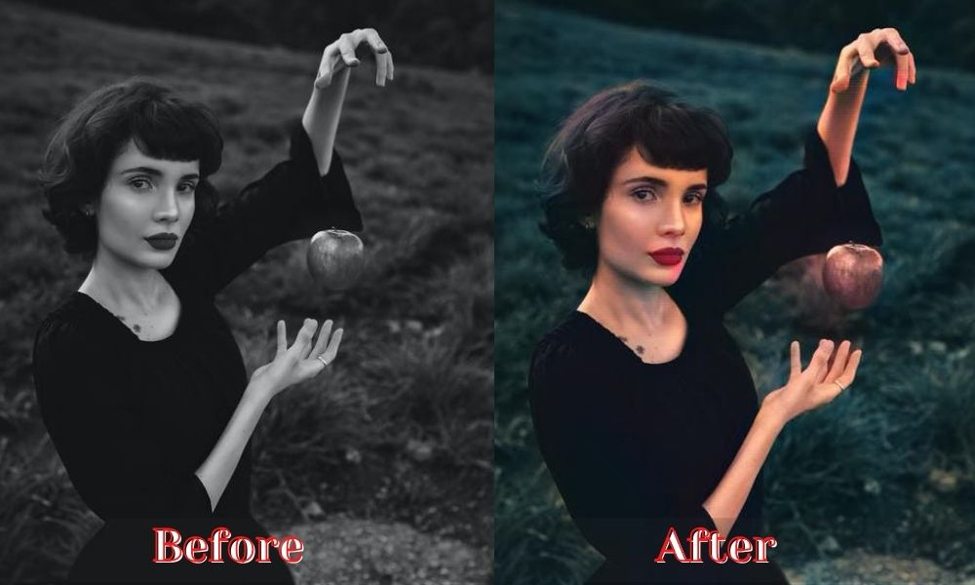
Deep learning in the real world
Deep learning is used everywhere!
To unlock your phone with face ID
When you use Google translate
Virtual assistants (Alexa, Siri)
Colourisation of black and white images

Slide 44

Deep learning in the real world
Deep learning is used everywhere!
To unlock your phone with face ID
When you use Google translate
Virtual assistants (Alexa, Siri)
Colourisation of black and white images
Snapchat filters

Slide 45
Deep learning in the real world
Deep learning is used everywhere!
To unlock your phone with face ID
When you use Google translate
Virtual assistants (Alexa, Siri)
Colourisation of black and white images
Snapchat filters
…and the list goes on!

Slide 46
…But how does it work?

Slide 47
…But how does it work?
Multilayer Perceptron (MLP)
Earliest neural network
Input layer
Hidden layer
Output layer

Slide 48
…But how does it work?
Feed forward
Input is passed forward through the network
Weights and biases extract interesting features

Slide 49
…But how does it work?
Feed forward
Back propagation
Backward pass through the network
Update weights and biases
Better correspond with desired output
Gradient descent

Slide 50
…But how does it work?
Feed forward
Back propagation
Backward pass through the network
Update weights and biases
Better correspond with desired output
Gradient descent with normalized values!
This is a VERY simplified explanation!

Slide 51
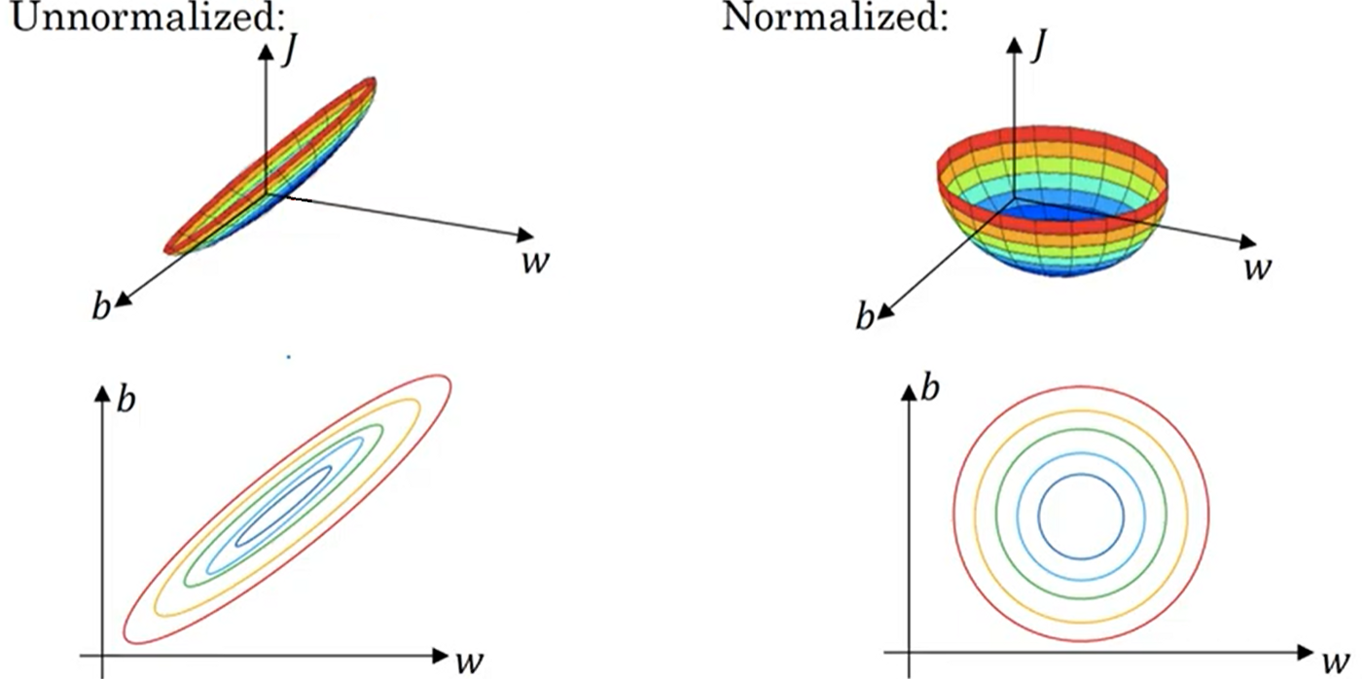
…But how does it work?
Normalize to find the
focal minimum much
faster.

Slide 52
…But how does it work?
For this workshop
Using Jupyter notebooks
Using Tensorflow 2.0
Access to Google colab for GPUs

Slide 53
…But how does it work?
For this workshop
Using Jupyter notebooks
Using Tensorflow 2.0
Access to Google colab for GPUs
The task
Create your own custom Deep Learning model to classify images!

Slide 54

Thank you!
Any questions?

